Slide 1
Business Forecasting
Group 6
ANVAY GOTHIVAREKAR
MIHIR SHAH
TRAVIS MCDOUGAL

Slide 2
Agenda
Introduction
Methodology
Recommendation
Q&A

Slide 3
Introduction
The data set being used for the project is a monthly sales data of a supply chain organization starting from 2016 to 2020. In this project, we are forecasting the demand for a subset of hair care products that are sourced from a distribution center in Whittier, CA. We will be looking at the sales figure of last 5 years in order to determine the demand. The long term purpose of this forecast is to help the distribution leads to adequately and effectively plan labor for the upcoming months. The simulation data was provided by the marketing team in order to complete the case study. The data was used to produce accurate forecasts using the R software. The data was then converted into a Time series in order to generate a number of forecast models and determine which is the best model to implement to produce accurate forecast results for this project.

Slide 4
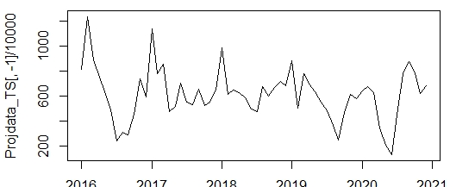
Introduction
Time Series Plot:

Slide 5
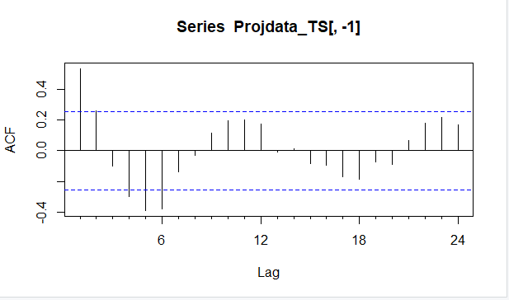
ACF:

Slide 6
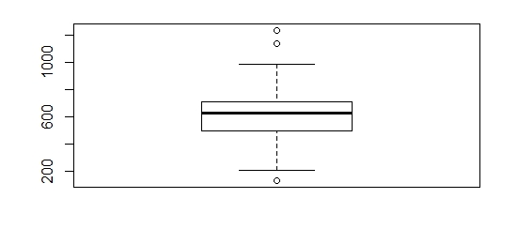
Boxplot for the Time Series:

Slide 7

Time Series Summary:
Time Series Inference: From the above time series plot, we can state that there has been an abrupt change at the start of the year 2018, due to which we can observe a downward trend moving forward. The Acf is a graph that is used to determine if a Time Series is dependent on its past observations. The above Acf plot shows that the most recent point of the observation is the most influential point in the time series.

Slide 8
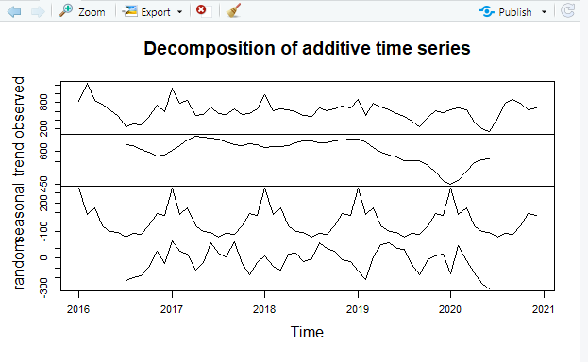
Time Series Decomposition:

Slide 9
Accuracy Metric
Determining the efficiency of forecast by using the Mean Absolute Scaled Error (MASE)
Why MASE?
MASE penalizes over and under forecasting.
MASE is suitable for data with trend/seasonal patterns
MASE can be used to compare forecast methods on a single series
Interpreting MASE?
A MASE score >1 needs a lot of work; the lower the better.
Notes:
Scale independency & interpretability

Slide 10
Methodology
In order to understand the data set better and provide accurate forecasts, we have performed a number of Forecasting and smoothing techniques which are as follows: 1. Mean Forecast. 2. Naive Forecast. 3. Seasonal Naive Forecast. 4. Random Walk Forecast. 5. ETS. 6. Holts-Winter. 7. Moving Averages. 8.ARIMA. Let us have a look at each of the model forecast and accuracy to understand them better.

Slide 11
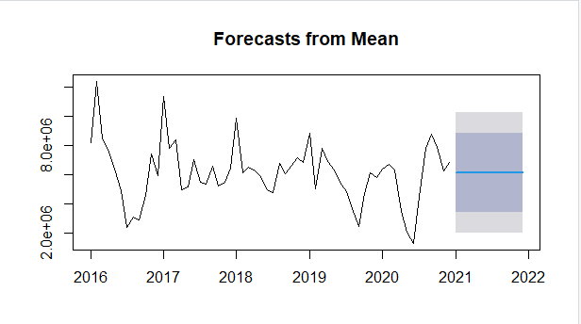
Mean Forecast:

Slide 12
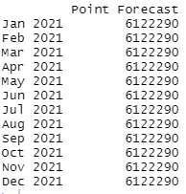
Output for Mean Forecast:

Slide 13
Accuracy for Mean Forecast:
Mean Forecast Inference: As the name suggests, Mean forecast returns the mean value of the data as the forecast for the future months. Mean forecast was performed in order to understand the data better to form further other models. MASE Score - 0.802

Slide 14
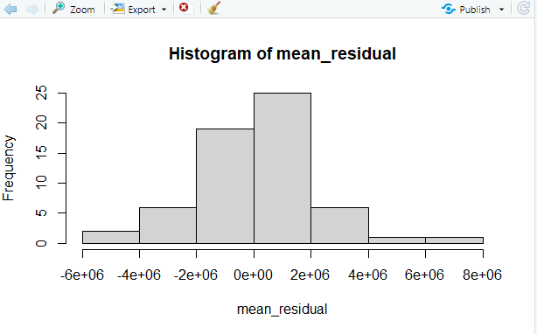
Histogram for Mean Residuals:

Slide 15
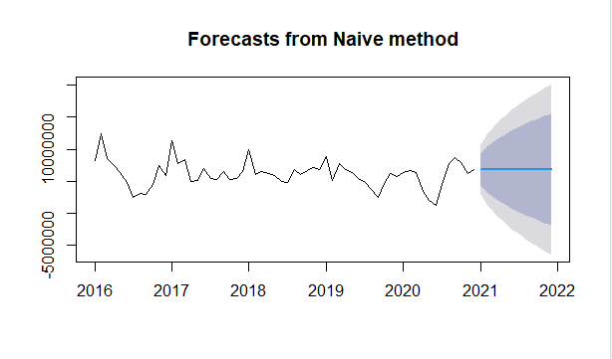
Naive Forecast:

Slide 16
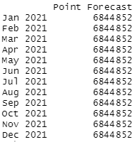
Output for Naive Forecast:

Slide 17
Accuracy for Naive Forecast:
Naive Forecast Inference: Naive method is mainly used as a benchmark to judge other models and when the process is fairly new. It is a model that uses the most recent data point to provide the future forecast. While forecasting, it is important to start with a Naive Model as it gives the forecaster an idea whether a more complex model is ideal or not for the forecasting in terms of performance. MASE Score - 0.816

Slide 18
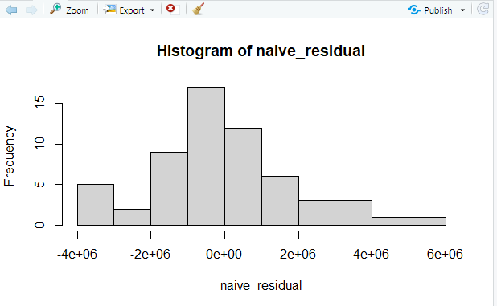
Histogram for Naive Residuals:

Slide 19
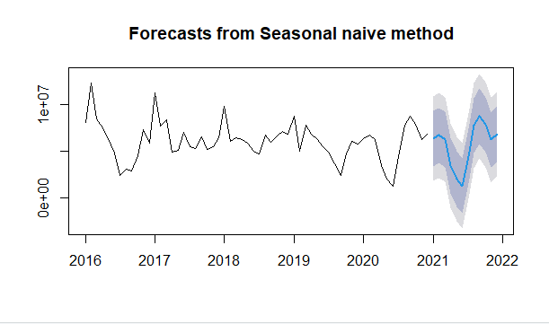
Seasonal Naive Forecast:

Slide 20
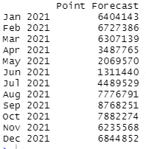
Output for S-Naive:

Slide 21
Accuracy for S-Naive Forecast:
S-Naive Inference: S-Naive is a seasonal naive model which is similar to the naive model to a lot of extent. However, in case of a S-Naive Model, we take the last seasonal observation instead of only the last observation. In the above S-Naive forecast plot also, we can see that the forecast is a repeating cycle of the last 12 months. S-Naive is basically an extension of the Naive method with some added complexity. When working on a data set that has very high seasonality, S-Naive is one of the efficient models to use. MASE Score - 1

Slide 22
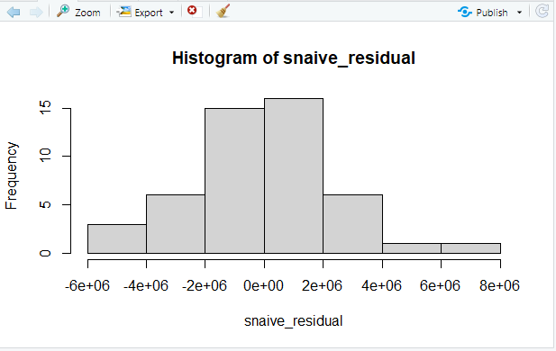
Histogram for S-Naive Residuals:

Slide 23
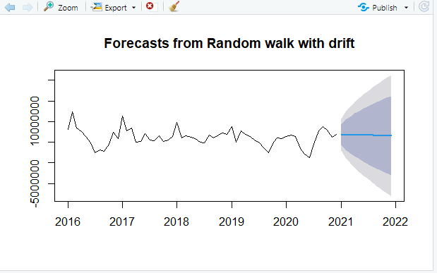
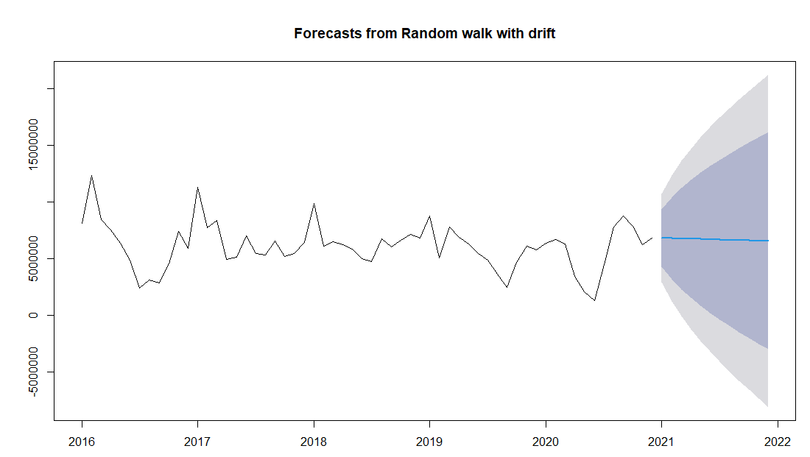
Random Walk Forecast:

Slide 24
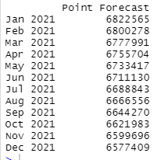
Output for RWF:

Slide 25
Accuracy for Random Walk Forecast:
RWF Inference: A Random Walk Forecast is similar to the Naive Model apart from the fact that it uses a drift model to return the forecast values. A RWF without drift model is a simple Naive model. A RWF model allows the forecast to increase or decrease over time based on the drift which is the average change seen in the data set. MASE Score - 0.815

Slide 26
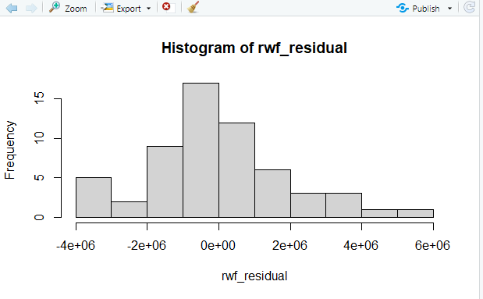
Histogram for RWF Residuals:

Slide 27
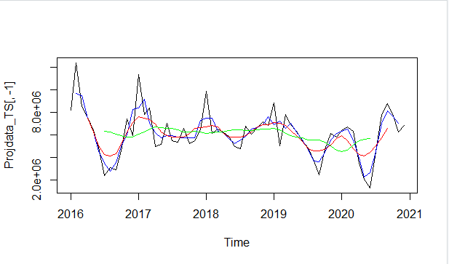
Moving Averages:
Notes:
REMOVE

Slide 28
Moving Averages Inference: Moving Averages is mainly used when the most recent observations in a data set are more relevant and influential than the entire data set. It is upto the forecasters discretion to determine the order of the moving averages depending on the data set. A small order indicates more weightage to the most recent points. A Moving Average method prominently captures the main movements of the Time series. A small order Moving Average is used when the data has sudden shifts at irregular intervals. Similarly, a large order Moving Average is used when there are wide infrequent fluctuations. A large order MA will generally smoothen the Time series curve.
Notes:
Remove

Slide 29
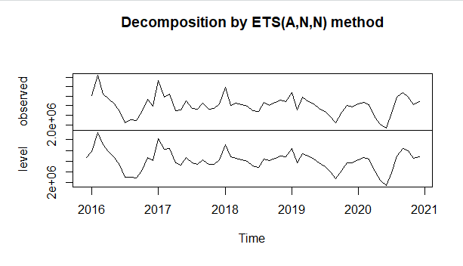
ETS Forecast:

Slide 30
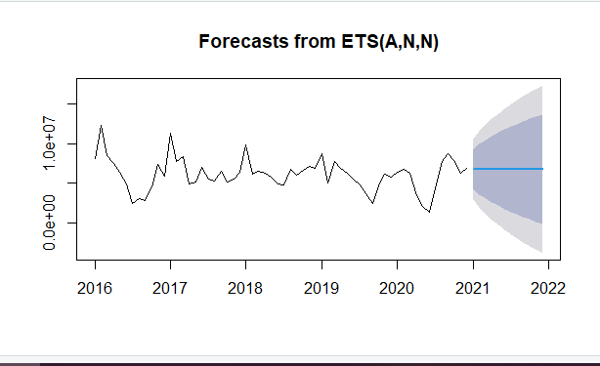
ETS Forecast for 12 Months:

Slide 31
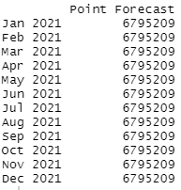
Output for ETS:

Slide 32
Accuracy for ETS Forecast:
ETS Inference: The ETS method focuses mainly on the Trend and Seasonal components of a Time series. A simple exponential smoothing ETS model is a (A,N,N) model with additive errors, No Trend and No Seasonality. If a particular model for ETS is not specified, a model which is best suited is automatically selected. MASE Score - 0.796

Slide 33
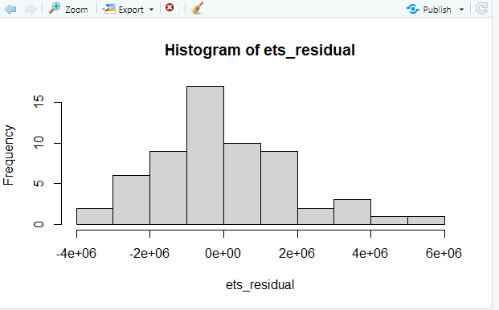
Histogram for ETS Residuals:

Slide 34
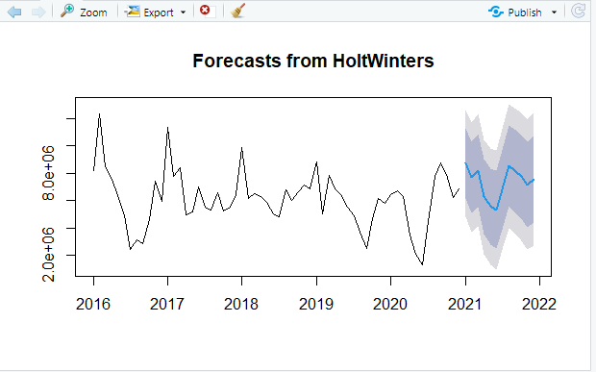
HoltWinters Forecast:

Slide 35
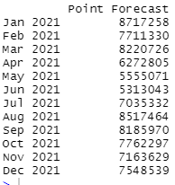
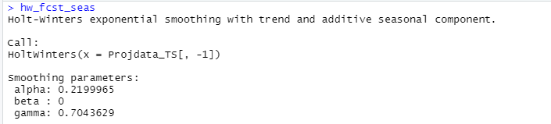
Output for HoltWinters:

Slide 36

Histogram for HoltWinters Residuals:

Slide 37
Accuracy for HoltWinters:
HoltWinters Inference: HoltWinters is a triple exponential smoothing for the Level, Trend and Seasonal components in a Time Series. It has three smoothing parameters namely alpha, beta and gamma. There are two methods for a HoltWinters model which is an additive method or a multiplicative method. MASE Score - 0.815

Slide 38
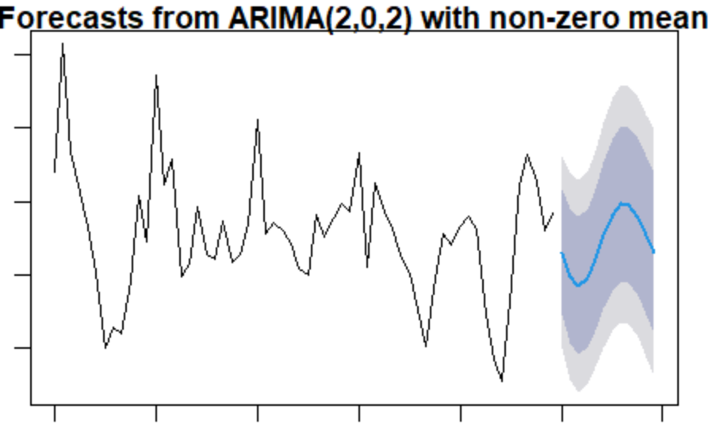


Box-Jenkins Model
ARIMA makes use of lagged moving averages to smooth time series data.
Process
Observe TS
Examin ACF & PACF for time lags
Match pattern to determine best ARIMA model
MASE Score - 0.536
Notes:
Assumptions: data is stationary (* if not stationary; differencing applied

Slide 39
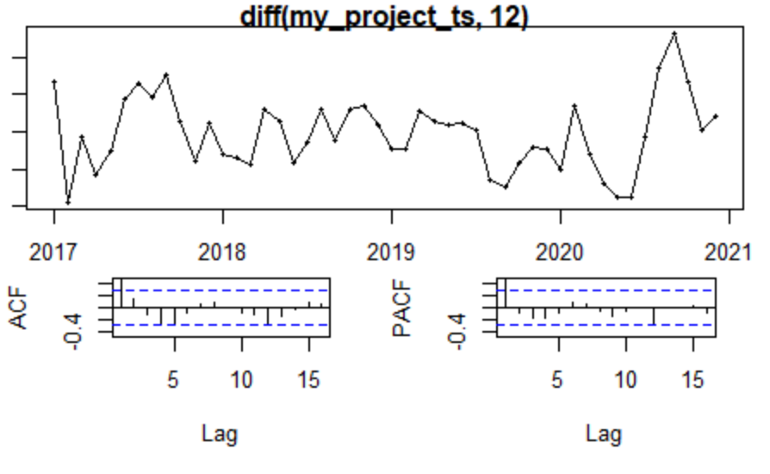

Slide 40
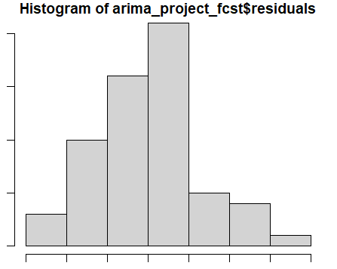
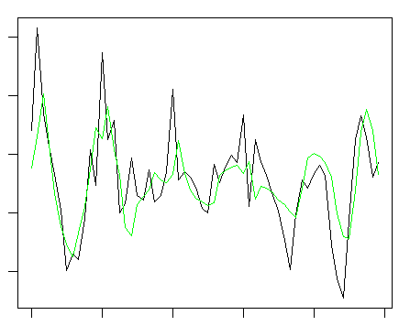
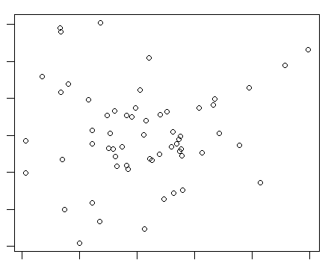
Box-Jenkins Model

Slide 41
Recap
The Task
Help the Operations team make labor planning decisions for the upcoming year for a distribution center.
The DC in addition to picking, packing, and shipping, the DC also manufactures goods.
Based on the best model we can provide a guidance to the teams teams based on the forecasted demand.

Slide 42
Accuracy Scores
Model | MASE Score
Naive | .82
SNaive | 1.00
ARIMA | .53
Holtwinters | .81
RWF | .82
Mean | .80
ETS | .79

Slide 43
Recommendation
Make Labor decisions based on the Arima model
Knowing that ARIMA model is intended for short term forecasts it is recommended that the is run on monthly basis
Additional inference about cyclical tendencies: January is seasonally high from a demand.

Slide 44
Q&A Any further suggestions and feedback can also be emailed below: Anvay Gothivarekar - ag1900@rutgers.edu Mihir Shah - ms3073@rutgers.edu Travis McDougal - travis.mcdougal@rutgers.edu

